Slide 1
Predicting the GDP
For Q1 of 2023 with Machine Learning
Darron Kotoyan, Nic Vamis, Drake Mueller, Kai Osaka

Slide 2



We Want to…
Predict Gross Domestic Product (GDP) based on 22 different time series variables for 2023 Quarter 1
Predict GDP for Quarters after to see if we are really headed toward a state of recession

Slide 3
Features
Stands for Gross Domestic Product
The market value of all final goods and services produced in a nation during a given time period
Essentially is the income and output of an economy
How many goods and services are produced and sold
Is released quarterly (every 3 months)
Evaluates the performance of an economy
A Recession is defined as 2 consecutive quarters of declining GDP, we want to predict if this will happen
Wh
What is GDP?

Slide 4

Our Data
We found all our data from the Federal Reserve Bank of St. Louis
Time Series Data ranging from January 1, 2000 - January 1, 2023
Used 22 Variables Total including GDP

Slide 5
Data Description
INDPRO: The industrial production index measures the real output of all relevant establishments
TCU-: Total Capacity Utilization, percentage of an organization’s potential output that is actually being realized
RSAFS: Total retail trade and food services
UMCSENT: Consumer sentiment
HSN1F:New single family houses sold
TTLCONS: Total construction spending
PERMIT: The number of new housing permits
HOUST-: New privately owned housing units started
CPIAUCSL: Consumer price index for all urban consumers
DCOILWTICO: Crude oil prices west texas intermediate
DCOILBRENTEU: Crude oil prices in Europe.
M1SL: The real money supply. Measure of most liquid assets.
M2SL: Small time deposits in billions of dollars adjusted seasonally
UNRATE: Unemployment rate
ICSA: Unemployment Insurance Claims
PAYEMS: Total Nonfarm payroll, a measure of U.S. workers that excludes proprietors.
RLTLT01USM156N: Long Term Government Bond Yields
FEDFUNDS: The federal fund effective rate
NASDAQCOM: Nasdaq composite index
BOPGSTB: Trade balance (Exports - Imports)
MORTGAGE30: 30 year fixed rate mortgage average in the U.S.

Slide 6
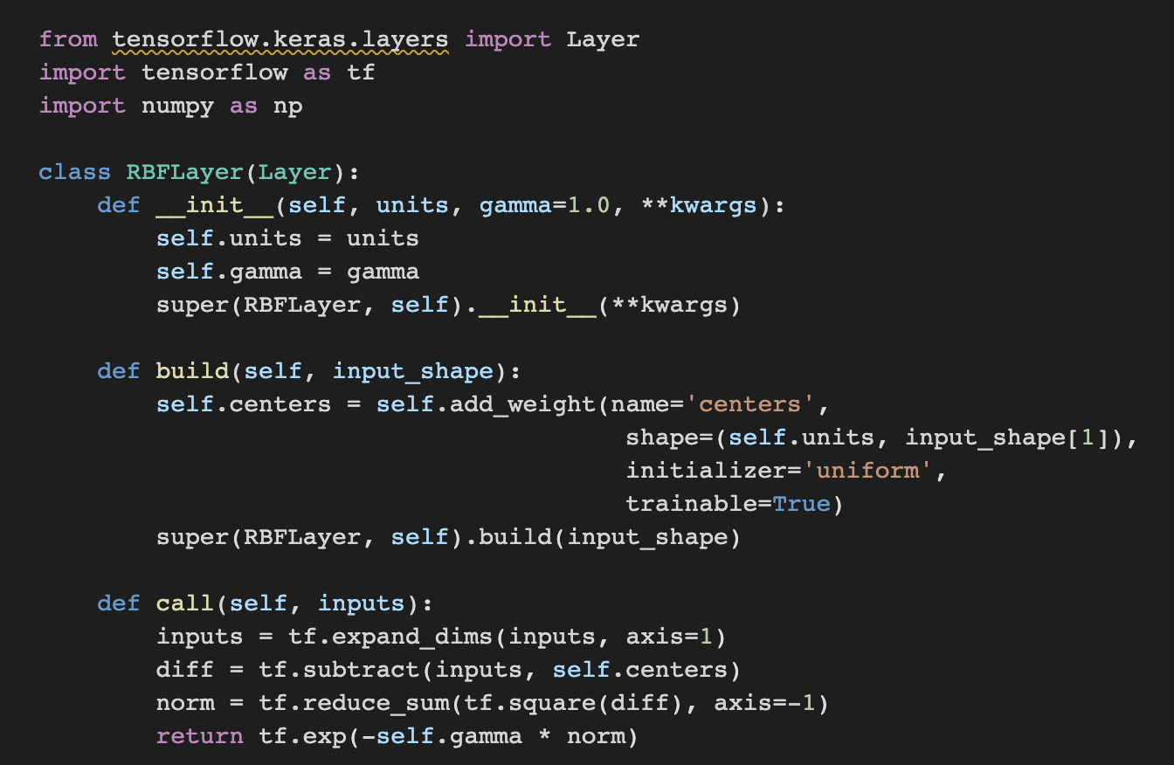
More Pre Processing

Slide 7
Our Model
2,000
Sequential
LSTM
Epochs
7
Activation Layers

Slide 8
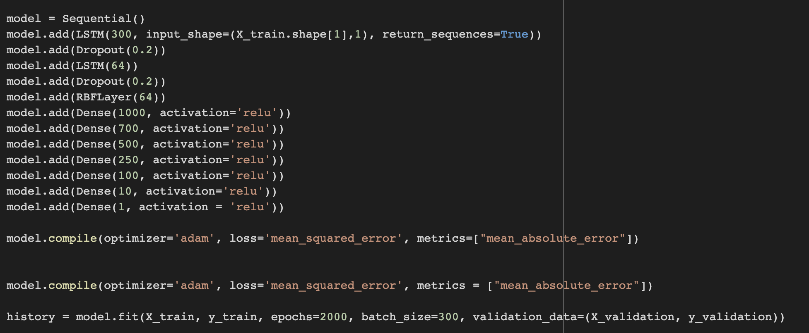
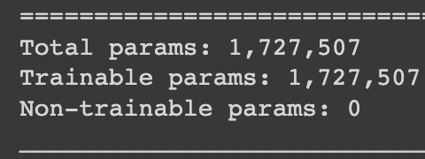
Model Architecture
Batch Size of 300
Loss function: Mean Squared Error
RELU Activation

Slide 9
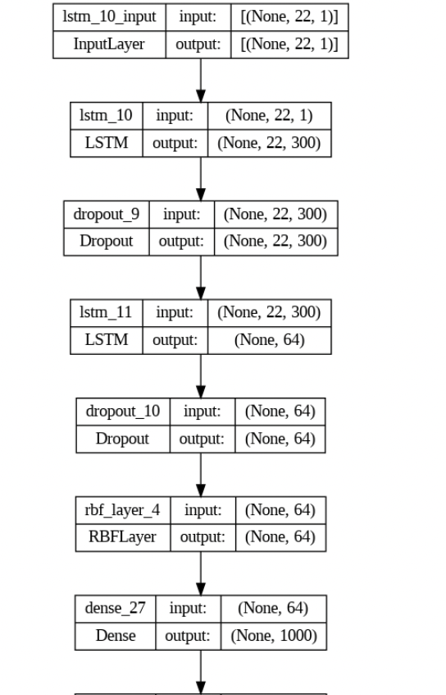
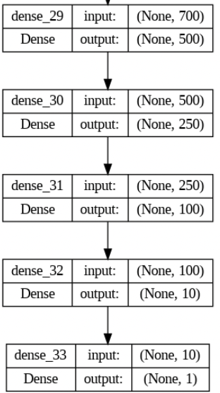
Model Architecture

Slide 10
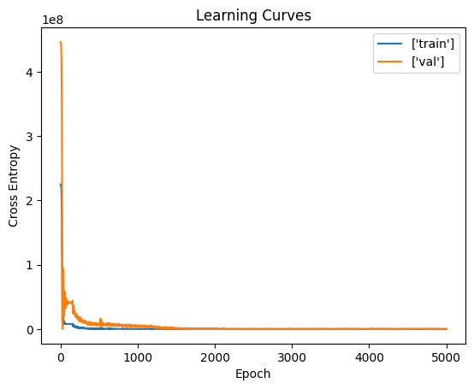
Model Tuning
Before the model was trained on 2000 epochs, we tried 5000
This is what we found
Only need 2000 epochs to achieve a similar learning rate & cross entropy outcome
We want Low Cross Entropy
The lower cross entropy is, the higher the probability of model accuracy is
It is also less computationally expensive

Slide 11
Results
*Range of value for GDP:
Highest: 26,465 in trillions
Lowest: 10,247 in trillions
High %
Accuracy
vs True Values
279.81
MAE Loss
120,183.344
MSE Loss
*Here what 5000 epochs got:
93,262.213 MSE
251.582 MAE

Slide 12
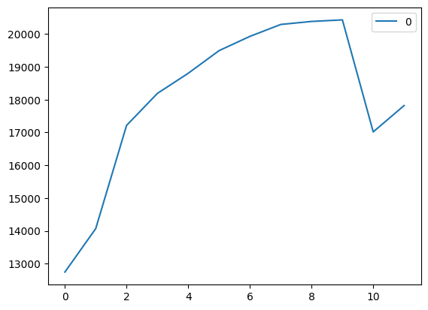
Predicted Test Values Over 12 Quarters
(11 due to split from train/val/test)
Starting from 2020 - Now
Model correctly predicts boost of GDP since start of 2020
Model predicted that GDP would fall in Q2 of 2022, but the real GDP actually grew… why?
In the beginning of 2022 inflation rates skyrocketed, inflation is a known tactic used to combat a falling GDP
CPI, inflation, and money
supply all slightly rose in this quarter

Slide 13
Future
Projection
Next, we wanted to use our model to project what GDP will be at the end of 2023 quarter 1
Selected data ranging from January 1, 2023 - March 1, 2023
Our model projected what GDP would be for each month of 2023

Slide 14
Future Projection
After fitting the new data to our model, this is what it predicted GDP to be in January-March
January: 17,603
February: 14,993
March: 14,889
Quarter 4 of 2022 ended on January 1, 2023 and the actual GDP was 25,465.86
So our model is projecting GDP to be much lower than it is and that GDP will decrease in quarter 1 of 2023
The model obviously uses all 22 of our predictors as well as previous actual and predicted values of GDP, so based on these indicators the model believes that GDP will decrease

Slide 15
So, Are We In a Recession?
As previously mentioned, a recession is defined as 2 consecutive quarters of decreasing GDP
Model Projections for 2022:
Q1: 20,381
Q2: 20,429
Q3: 17,017
Q4: 17,818
2023 Q1: 17,603
So as of right now there is 1 decreasing quarter
there is a downward trend in GDP
All indicators show that the recession is coming

Slide 16
Future Steps
We want to focus on adding more predictor variables to increase accuracy
Run PCA or Lasso to drill down on key features
Continue to generate visualizations validating the model
Introduce volume into model which may change the structure of architecture

Slide 17
Thank You

